Slide 1


Slide 2

USER-BASED
COLLABORATIVE
FILTERING
MOVIE
RECOMMENDER
SYSTEM

Slide 3
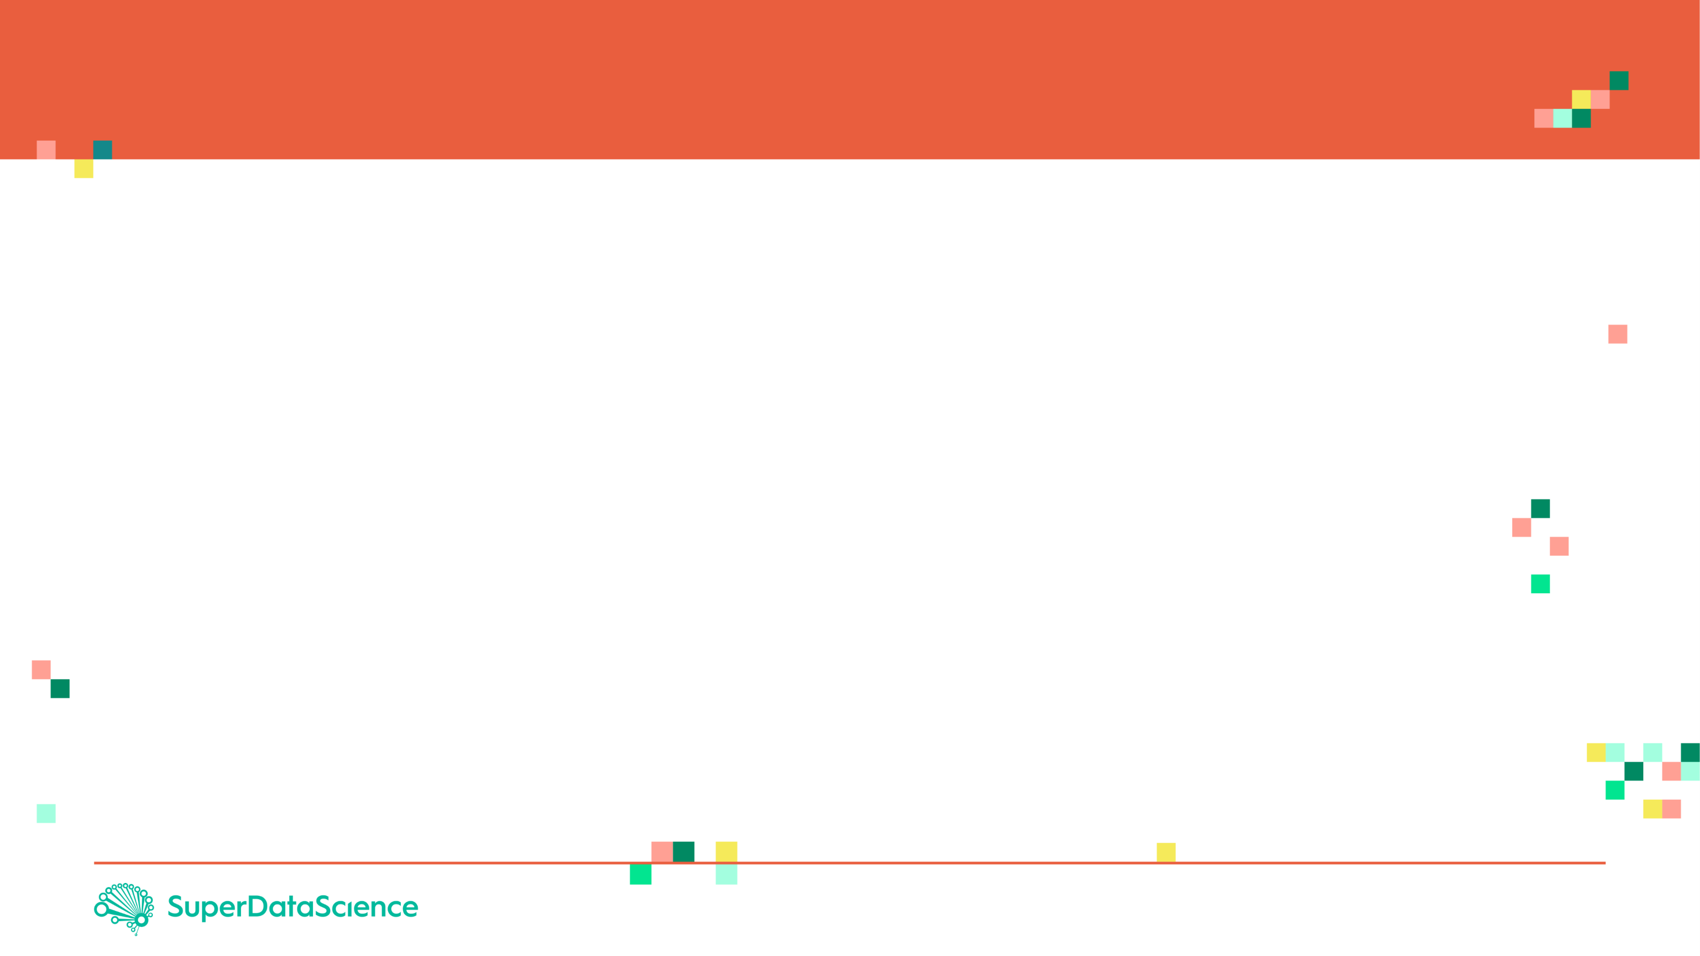
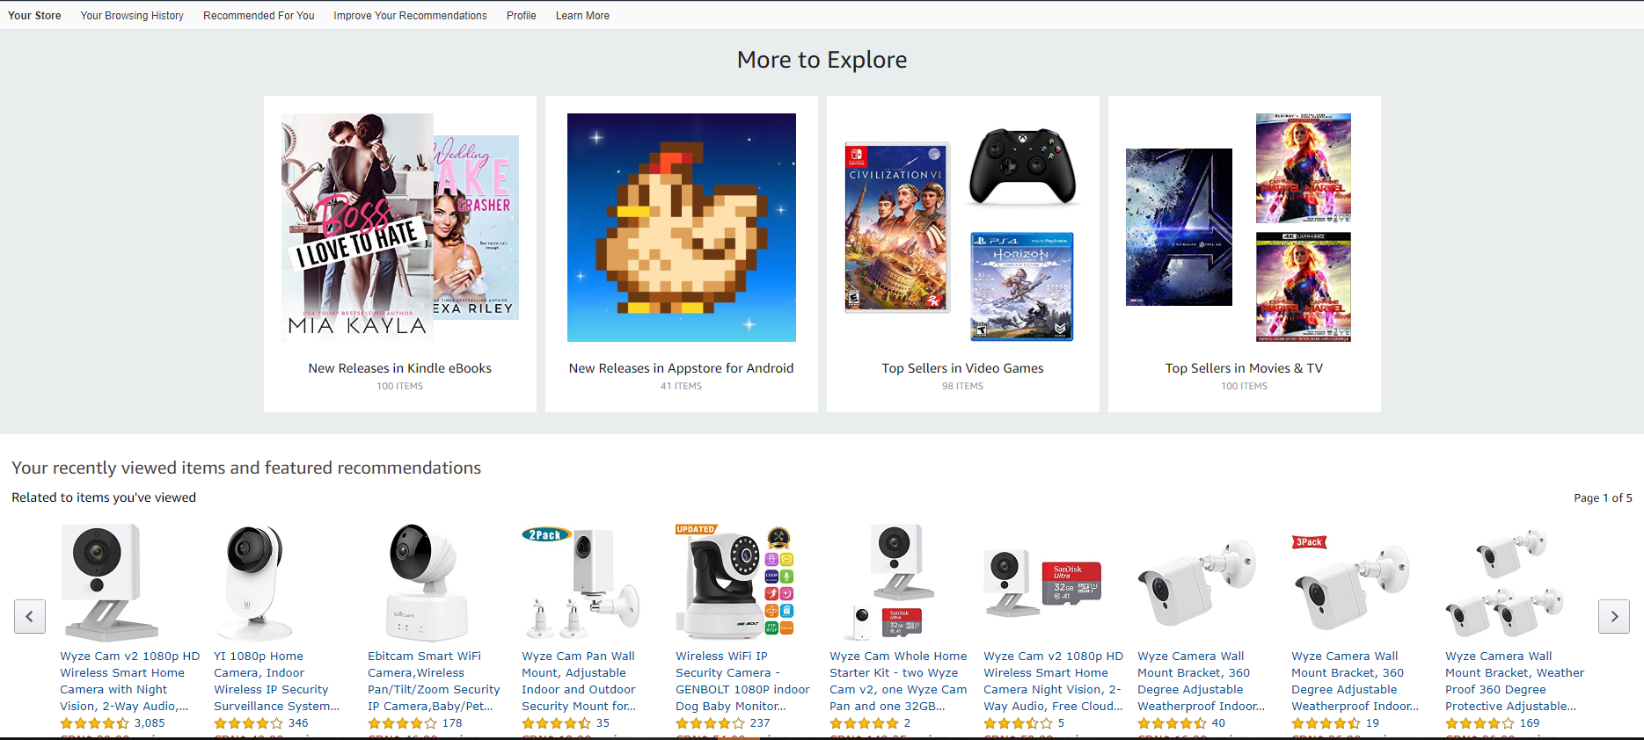
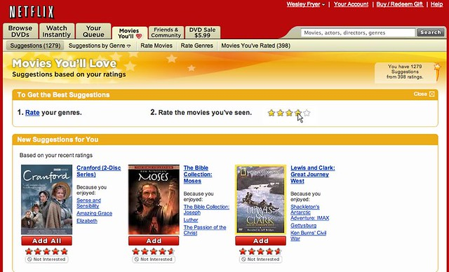
PROJECT OVERVIEW
Recommender systems are algorithms designed to help users discover movies, products, and songs by predicting the user’s rating of each item and displaying similar items that they might rate high as well.
The objective is to show customers content that they would like best based on their historical activity.
Photo Credit: https://www.flickr.com/photos/wfryer/2661730729

Slide 4



RECOMMENDER SYSTEMS: USER-BASED COLLABORATIVE FILTER
User-based collaborative filtering works by building a matrix of every piece of content that users bought or viewed.
Similarity scores are then calculated between users to find similar users to each others.
For similar users, content that have not been viewed or bought are recommended to users that haven’t seen them before.
SIMILAR USERS
Photo Credit: https://www.maxpixel.net/Account-Symbol-Web-Icons-User-Rodentia-Icons-1293744

Slide 5
RECOMMENDER SYSTEMS: USER-BASED COLLABORATIVE FILTER LIMITATIONS
More users than products, movies..etc so making the problem more complex (~8 billion people!)
Users taste change over time.
Let’s explore another strategy that overcomes the limitations of User-based collaborative filtering. This strategy is named item-based collaborative filtering.

Slide 6
RECOMMENDER SYSTEMS: ITEM-BASED COLLABORATIVE FILTERING
Item-based collaborative filters work by recommending elements based on relationship between items and not people.
The recommender system is now designed based on items (such as movies) and not users.
This reduces the complexity of the problem and overcomes the challenges of user-based collaborative filtering.
Unlike humans, movies, songs, and products features and tastes do not change over time.

Slide 7
RECOMMENDER SYSTEMS: ITEM-BASED COLLABORATIVE FILTERING
Based on User #1 and #2, they both watched and liked Titanic and a walk to remember.
Item-based collaborative filtering will correlate both movies together based on user #1 and #2 behaviour.
User #3 watched “Titanic” and did not watch a “Walk to remember”, so the recommender system will recommend it for him/her.
SIMILAR ITEMS
Photo Credit: https://www.maxpixel.net/Account-Symbol-Web-Icons-User-Rodentia-Icons-1293744

